Slide 1
Climate and Vegetation

Slide 2
Equatorial climate
Many regions close to the equator experience an equatorial climate. These regions 0° - 10° N and S of the equator include, the Amazon Basin (South America), the Congo Basin (Africa), Malaysia, Indonesia and some areas in northern Australia

Slide 3
Characteristics of Equatorial Climates
Regions with this climate experience high temperatures all year round. The average monthly temperatures are about 26 – 28 degrees Celsius but seldom reach above 30°C. The annual temperature range (the difference between the average temperature of the hottest and coldest months) is very small. The annual temperature range may be as low as 3 degrees Celsius. The diurnal or daily temperature range (the difference between the highest temperature in the day and the lowest temperature at night) is usually greater
Humidity is usually very high, over 80 per cent.

Slide 4
Characteristics of Equatorial climates
Another major characteristic of this climate is the heavy, regular and well-distributed rainfall. These regions usually experience 2000mm - 3500mm mm of rainfall or more in a year. Rainfall is high for most of the year
Many equatorial regions are affected by the ITCZ. As the ITCZ passes over these areas it brings heavy rainfall and thunderstorms. In some areas, the ITCZ causes two periods of very heavy rainfall every year. One occurs when the ITCZ crosses these areas on its way north and another occurs when it crosses these areas again on its way south.
Convectional rainfall is also a feature of this climate
The climograph below shows the rainfall and temperature pattern of an area which experiences an equatorial climate.

Slide 6
Vegetation in Equatorial regions: Equatorial Forests
Equatorial rainforests have very dense vegetation. Many different types of trees and other plants can be found growing in a relatively small area of rainforest. More species of plant can be found in a rainforest than in other type of plant community. Four square miles of rainforest may contain as many as 750 species of tree and 1,500 species of flowering plant.
Rainforests cover only about 6 percent of the Earth’s surface. However, they contain about half of the world’s known animal species and provide about 40% of the world’s oxygen.

Slide 7
Equatorial Forests
There are several layers of vegetation in a rainforest. The uppermost layer is made up of the crowns of the tallest trees. These trees are known as emergents. They are much taller than most trees in the rainforest and their crowns are exposed to the direct sunlight. Some trees such as the kapok may reach heights greater than 200 feet (61 meters).
The next layer is known as the canopy. The crowns of the trees in this layer are about 20 meters (about 65 feet) to 40 meters (about 130 feet) high. The crowns of the trees in this layer are tightly packed together forming a nearly unbroken cover for the forest floor. If you were looking down on a section of the rainforest from above, you would not be able to see the ground. Because of the cover provided by the canopy, very little sunlight reaches the lower layers of the rainforest.

Slide 8
Equatorial Forests
Below the canopy is another layer known as the understory. Trees in this layer are only a few meters high. Here one can find trees which only grow to about 15 meters at maturity as well as young saplings which will eventually grow to reach the canopy. Sunlight here is limited.
Between the understory and the forest floor lies the shrub layer. It is composed of small plants such as ferns and small shrubs. Only about 1% or 2% of sunlight reaches this layer. Therefore, few plants are able to thrive there. The few plants which grow here must be able to tolerate low light conditions. It is easy to walk through the rainforest because the area near ground level is relatively free of vegetation. The diagram below shows the layers of the rainforest.

Slide 10
Equatorial Forests
In rainforests, a layer of leaf litter can be found on the forest floor. Because of the moisture, high temperatures and the many decomposers, these leaves and any other organic matter decay very rapidly. Their nutrients are returned to the soil where they are taken up by plant roots. In this way, nutrients are recycled quickly and efficiently in rainforests.

Slide 11
Soil in Equatorial Forests
In many tropical areas, chemical weathering has produced a reddish clay soil. The soil itself is not very fertile. However, in a rainforest, there is a continuous supply of leaves, animal droppings and other organic matter which are quickly broken down with the help of decomposers and incorporated into the topsoil. Because of this process, the soil in the rainforest is able to support the dense vegetation. However, once the vegetation is removed, the soil quickly loses its fertility.

Slide 12
Adaptations of vegetation in Equatorial Forests
The trees of the rainforest have adapted to the high temperatures and heavy rainfall in equatorial regions. The leaves are often dark green and thick to protect them from the intense sunshine while maximizing transpiration and photosynthesis. They often have pointed tips called drip tips which allow rain water to drain off quickly. Rainforest trees also called selva, do not need thick bark to prevent moisture loss. Therefore their bark is usually thin and smooth.
Many trees are tall and have a relatively straight trunk. The branches and leaves are concentrated near the very top of the tree to maximize the amount of sunlight they receive. Having leaves on the lower parts of the trunk would not be very useful as very little sunlight would reach them.

Slide 13
Adaptations….
In order to support their great height, many trees have buttress roots (also called plank buttresses) which extend above the ground and along the trunk on all sides. The buttress roots of a tree can be seen in the photo.

Slide 15
Adaptations…
Apart from the trees, many other forms of plant life can be found in a rainforest. They have adapted to life in a rainforest as well. Some plants in the lower layers of the rainforest have very large leaves in order to make efficient use of the little sunlight which reaches them. Some plants, known as lianas, are vines which are rooted in the soil and grow up the trunks of trees all the way into the canopy where their leaves can get more sunlight.
Some plants, known as epiphytes, grow on trees (their roots are not in the soil). They do not harm the trees and they do not get their nutrients from them. They only use the trees for physical support (see photo)

Slide 17
Adaptations…
There are other plants which are parasites. They grow on other plants and get their nutrients from them, damaging them as they do so.
There are other plants known as strangler figs. They start out by growing on a host tree. Then they grow long roots down the trunk of the tree and into the soil. These roots grow larger and begin to surround the trunk of the host tree. Eventually the host tree will die, leaving the strangler fig in its place. In the photo below, the roots of a strangler fig can be seen wrapped around the trunk of a host tree.

Slide 19
Tropical Marine Climate
Many islands and coastal areas located 10 to 20 degrees north or south of the equator experience a tropical marine climate. These areas include most Caribbean islands as well as coastal areas of territories such as Guyana. Central America, Madagascar, the Philippines and parts of East Africa also experience this climate.

Slide 20
Characteristics of Tropical Marine Climates
As the name implies, the sea has a strong influence in places which experience this type of climate. The trade winds blow all year long. In the Caribbean, for instance, the northeast trade winds blow from the Atlantic across the islands. These winds pick up much moisture over the Atlantic and often cause relief rainfall as they rise over mountainous areas in the region. Places with a tropical marine climate often experience tropical waves especially during the wet season. The Caribbean is affected by tropical waves which form as far away as Africa and cross the Atlantic before reaching the region. Places with this climate may also experience hurricanes which form over warm oceans and seas.

Slide 21
Characteristics of Tropical Marine Climate
Regions which have a tropical marine climate experience between 1200 mm and 2000 mm of rain annually. Rainfall is seasonal to a certain extent. There are wet and dry seasons though they are not as extreme as those in the tropical continental climate. There is more rainfall during the wet season and less rainfall during the dry season.
Regions which experience a tropical marine climate have high temperatures all year round. The annual temperature range is often quite small. However it can be up 10 degrees Celsius in areas farther way from the equator. Temperatures are higher during the wetter season and lower during the drier season. The climograph below shows the rainfall and temperature pattern of a country which experiences a tropical marine climate.

Slide 23
Vegetation and Soil in Tropical Marine Climates
Chemical weathering tends to produce a reddish clay soil in areas with a tropical marine climate. The soil may be quite deep. The type of vegetation which found in any particular area depends on the conditions existing there, such as the amount of moisture available and the length of the dry season. As such, there are many types of vegetation that may develop in this type of climate. Let us examine a few.

Slide 24
Rainforest
In some areas the drier season is relatively short or there is enough rainfall during the drier season to support plant growth. In these areas, the ecosystems which develop are very similar to the true rainforests which develop in equatorial climates. This is the case in the wetter parts of many Caribbean territories including St. Lucia, Trinidad, St. Vincent, Jamaica and Belize.

Slide 25
Semi- Evergreen Forest
In some areas, the drier season is longer or there is much less rainfall in the dry season. In these areas, semi-evergreen forests tend to develop. To conserve moisture some plants in this ecosystem have small leaves. For the same reason, many of the plants in this type of forest shed their leaves during the dry season. These leaves remain on the forest floor until the wet season when the abundant moisture causes them to decompose (see photo below).

Slide 27
Semi- Evergreen Forest
In semi-evergreen forests, there are only two tiers or levels of trees and there are not as many types of tree as in a rainforest. The trees are not as tall as rainforest trees and there are fewer lianas and epiphytes. . Examples of this type of forest can be found in many areas in the Caribbean including Stony Gully in Barbados, Wallings in Antigua and King’s Hill in St. Vincent.

Slide 28
Dry Woodland
This type of vegetation is found in the driest areas such as rain shadow areas and areas where the dry season is long or relatively severe. Plants which exist in these conditions must be able to deal with the lack of water in the dry season. Many have thick bark to conserve moisture. Many have small leaves or shed their leaves in the dry season. There are very few species of tree and the trees are usually quite small (usually less than 25 meters tall).

Slide 29
Tropical Montane Forest
Tropical montane rainforests are found in mountainous regions in the tropics at altitudes of about 1000 meters or more. It is generally cooler in these regions than at lower elevations. There is more cloud cover in these areas. There is more moisture available as there is more rainfall. The ground and vegetation are often moist. Due to the abundant moisture, trees are often covered in mosses and epiphytes (see photo below). Ferns are common.

Slide 31
Tropical Montane Forest
Because of the lower temperatures, trees in this type of forest do not grow as tall as trees in the forests in lowland areas. There are usually only two tiers or layers of trees.

Slide 32
Mangrove
Mangrove trees grow in areas with low oxygen soils where water flows slowly, allowing fine sediment to accumulate. Unlike many plants, they are able to thrive in saline conditions or brackish water where fresh water and sea water mix. There are over 80 species of mangrove. They can usually be recognized by their stilt roots which hold the trees up above the water level. Mangrove forests can be found in coastal areas in tropical and subtropical regions. Mangrove forests help stabilize the coastline. Their roots also serve as a breeding ground or a habitat for many aquatic animals.

Slide 34
Beach Vegetation
A distinctive type of vegetation tends to develop along beaches. While many soils are able to retain water to support plant growth, water drains very easily through sand. The sand does not contain many nutrients and it has a high salt content. The plants which grow along our beaches must be specially adapted for dealing with these conditions. Unlike many plants, they are able to tolerate the high levels of salt. Many have small or waxy leaves to reduce water loss. Others are able to store water in their stems or root systems.

Slide 35
Beach Vegetation
The plants which grow closest to the sea (just above the high tide line) are called coastal pioneers. These plants are able to thrive in the harsh and unstable conditions near the sea. Many of these plants, such as seaside bean and beach morning glory, grow by creeping along the ground. Others are grasses such as seashore paspalum.
A little farther from the sea, the soil is more stable and some humus is present. In this zone, there are still some grasses and creeping plants like those mentioned before. There are also many woody plants such as fat pork and bay cedar. These woody plants may grow clustered together forming a hedge.

Slide 36
Beach Vegetation
Still farther from the sea, along with many varieties of woody shrubs, trees are found. Among the trees often found in this zone are sea grape, seaside maho and the poisonous manchineel tree. See photos on following slides.

Slide 37
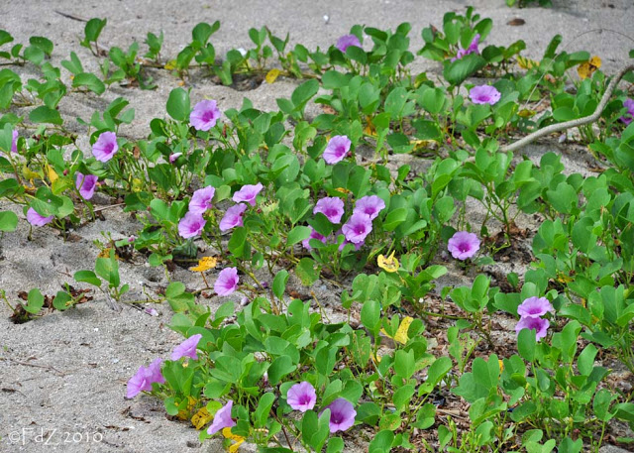
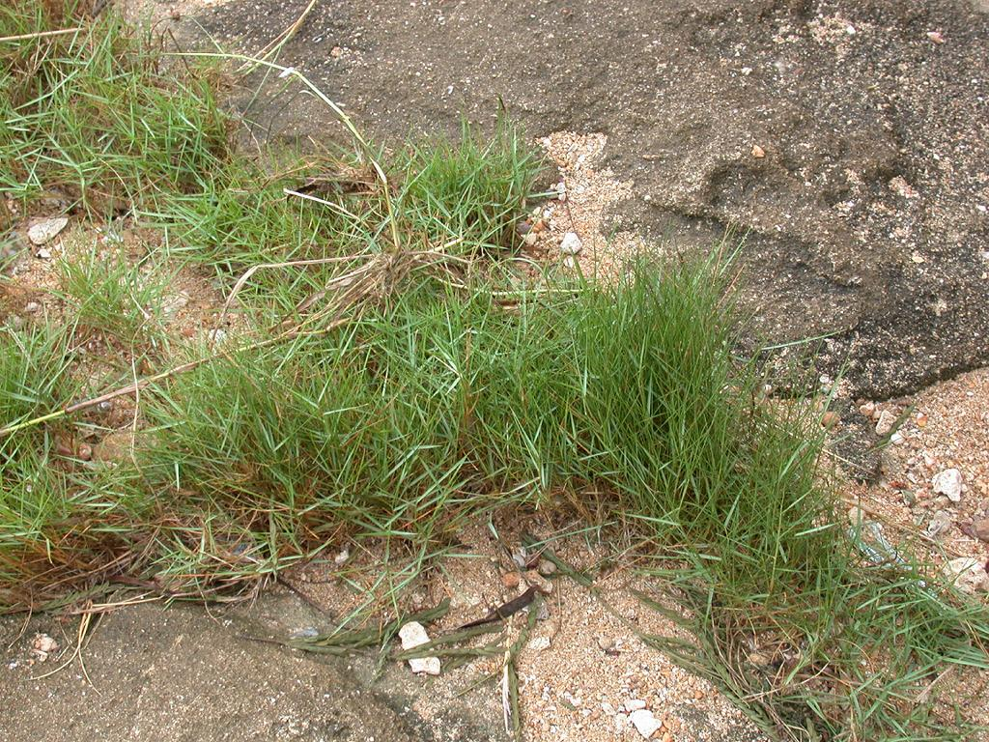

Slide 38
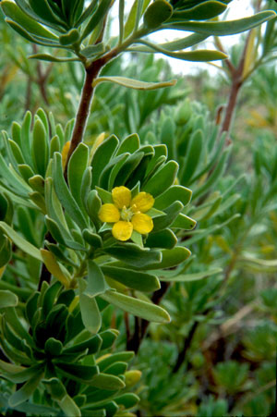
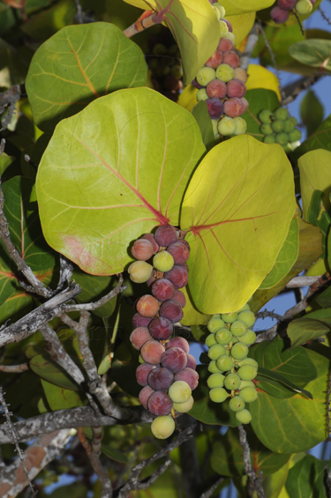

Slide 39
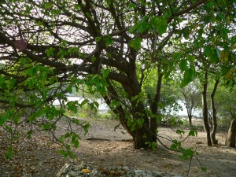

Slide 40
Review
State four characteristics of the climate of equatorial regions.
Describe four adaptations of vegetation to the climate in equatorial regions.
Identify the location of places that experience tropical marine climate.
Why is there little undergrowth in the equatorial forests?
Describe three characteristics of climate in tropical marine regions.
How is the soil of equatorial regions able to support dense vegetation?

