Slide 1
River erosion

Slide 2
River erosion
The process of wearing away of the rocks on the bed and banks of the river by the energy of the river flow.

Slide 3
River erosion also happens by the load carried on the river channel itself.
The erosion rate varies with different volume and velocity.

Slide 4
Processes involved in river erosion.
Corrasion (abrasion)
Attrition
Solution (corrosion)
Hydraulic action

Slide 6
Types of river erosion
Vertical erosion
Headward erosion
Lateral erosion

Slide 7
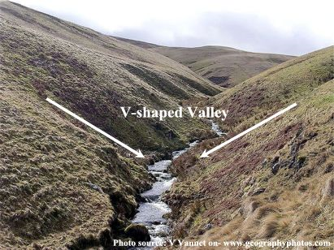
Vertical erosion
River removes material from river bed
By corrosion/abrasion process
Result: Deepens a river channel and creates narrow V-shaped valleys.

Slide 8
Headward erosion
River cuts its source
Results: lengthening of the river in the upstream direction

Slide 9
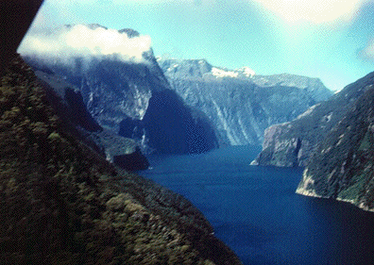
Lateral erosion
The wearing away of river bank
By a solution process.
Result: widens the river and forms wider shaped valleys.

Slide 10
CAURA RIVER

Slide 13
Quiz
1. What is the name given to the sheer force of water.
a. Hydraulic action
b. Chemical action
c.. Attrition
2. When water dissolves the rocks it is called
Corrasion
Solution
Attrition
3. When pebbles and rocks hit off each other and break up it is called
a. Attrition
b. Hydraulic action
c. Corrasion

Slide 14
4. What do you call the erosion of the river bed by the load?
Corrasion
Attrition
Hydraulic action
5. The wearing away of the side of the river banks is the result of
Headward erosion
Lateral erosion
Vertical erosion
6. Vertical erosion occurs when …
Sides of the banks are eroded
The river bed is eroded
c. The river retreats upstream

Slide 15
Answers
A
B
A
A
B
B

Slide 16
task
Compose an artistic piece portraying AT LEAST two (2) types /processes of river erosion in a river channel. You can create a poem, rap, song, dance or drawing. Your performance must be about 1 – 1 1/2 minutes long. Credit will be given for:
Accurate information
Clear strategy – there must be a narrator
Impact – entertaining yet informative.

